Slide 1
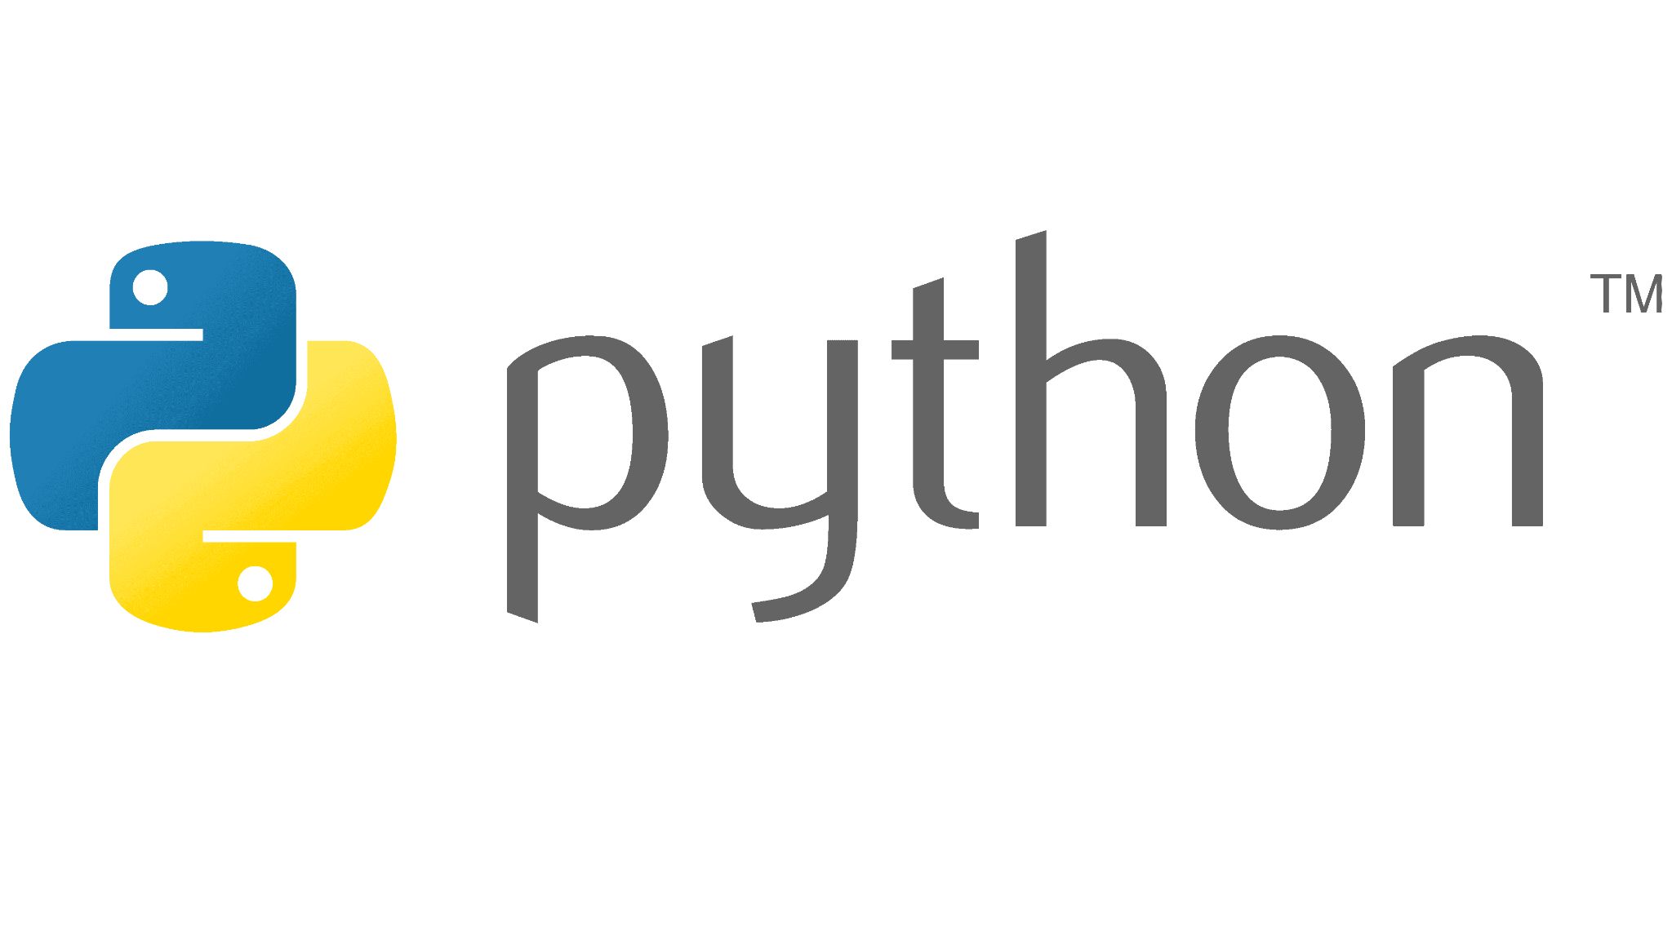


Slide 2

Last lecture reminder
We learned about:
How to represent objects in python
What is the dictionary data structure
How to add / update / delete / get elements with python dictionary
What are the main differences between arrays and dictionaries
What is the tuple data structure
How to get elements from python tuples
When should we use python tuples

Slide 3
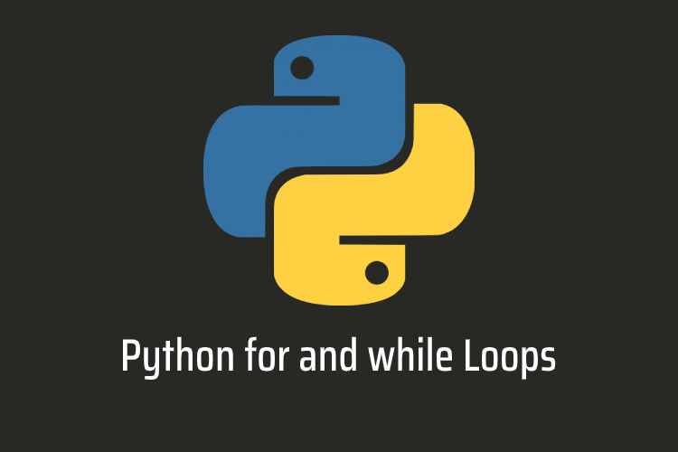

Slide 4
What are loops in Python?
Sometimes we will have a use case where we will want to run our code repeatedly just with different value. For example: Let’s say we want to print the line: “This is my number” for 5 times. How can we do it?
First option - write the print command to the IDE for 5 times.
Second option - use Python loops.

Slide 5
Different types of loops in Python
In Python we have 2 types of loops we can choose from:
for loop - loop through a block of code number of times
while loop - loop through a block of code while a specific condition is true
Note: In other programming languages we also can find another loop type called do-while loop, which Python is not supporting. However the for and while loops are the most used in all languages.

Slide 6
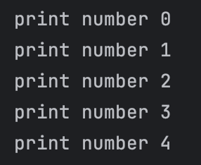
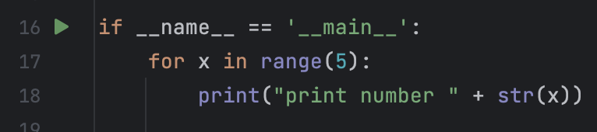
For loop syntax
By using the for keyword we are announcing on a new for loop
Then we need to determine how many times we want the for loop to run. We are doing it by providing 3 statements to our for loop:
First statement - declare the variable we want to use as the counter (x)
Second statement - set the condition for executing the code in the for loop block (in)
Third statement - set the number of iterations we want our loop to execute (range(5)) The range() function can be provided with both start and ending points as well.

Slide 7
For loop syntax
Once we have our statements ready we can write our for loop block by using the : symbol. The code we will put below this symbol will be called as the loop block and be executed on every loop iteration. We can also use the variable we create in the for loop statements to check on the iteration we currently are.
Note: In the example above, we are using a new variable called x, the scope of this variable is only inside the for loop block.

Slide 8
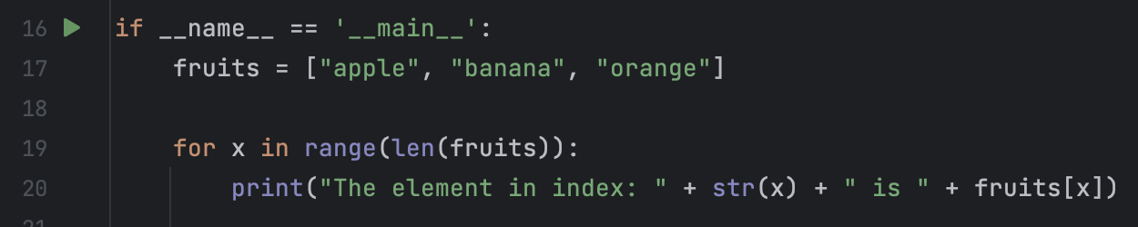
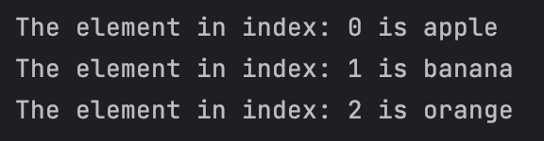
For loop with index - Example
For loops can also help us to iterate through objects like arrays. In order to do that we need to use the array length property for setting the loop stop condition.
Note: This for loop ability allow us to iterate now on different element inside any data structure and perform specific action on each of those elements. This can now save us a lot of duplicate code and can make our lives much easier.
We are using the length of the array as the stop condition

Slide 9
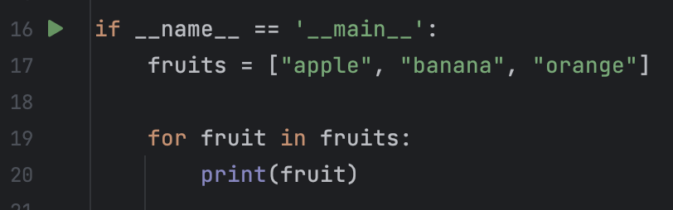
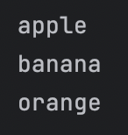
For loop without index - Example
The Python for loop also provides us another way that can be simpler to loop on all the elements in a given array. Instead of using the array length in the range() function to extract the index of the elements we can just enter directly to the element itself in the same order of the array:
We are using the in keyword to get the element itself from the array without using the index

Slide 10
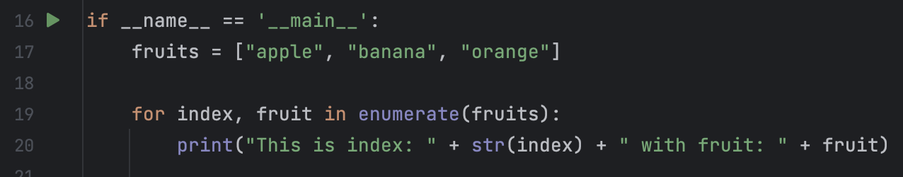
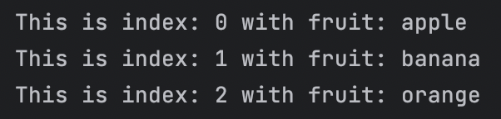
For loop on enumerate object - Example
We can also do the same for loop logic with getting the element index as well as the element itself. In order to do that we need to use the Python enumerate() function.
The enumerate() function returns an enumerate object, which is an iterator containing pairs (tuples), where the first element is a count (from the start parameter, which defaults to 0) and the second element is a value obtained from iterating over the sequence.
For example:
We are converting the array to enumerate object and then use this object in our for loop to get the index and the element itself

Slide 11
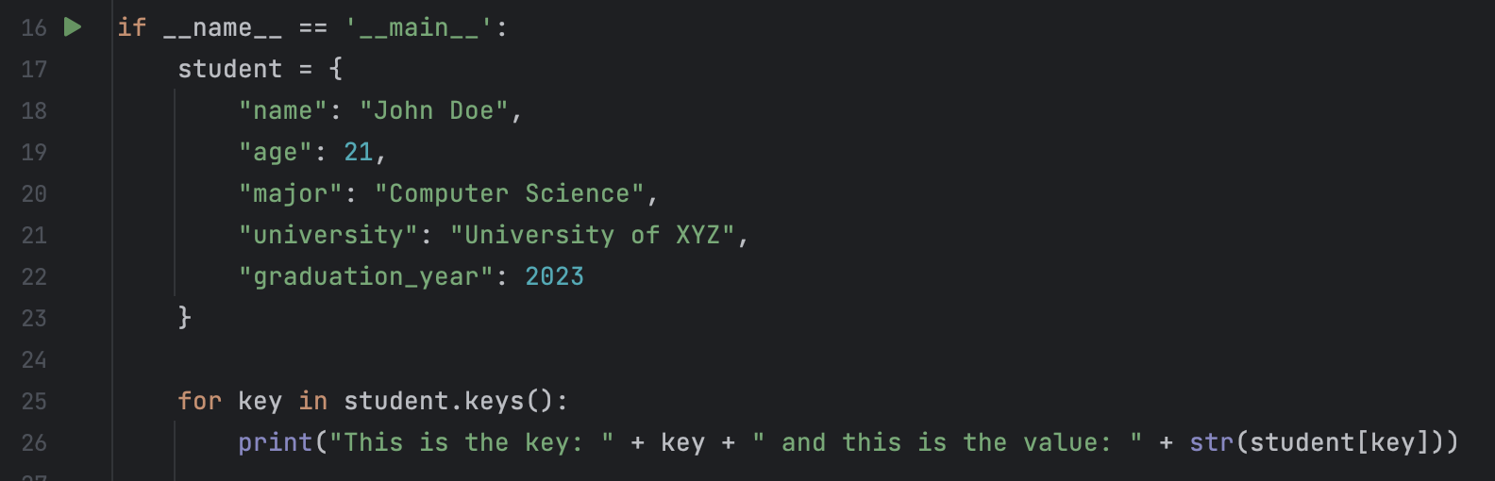
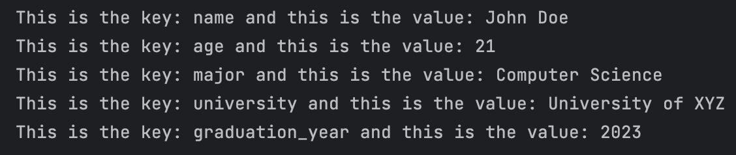
For loop with dictionary
If we will want to iterate on the entire key-value pairs in a specific dictionary, we can also do that using the for loop. For example:
We are looping on the entire key set in the dictionary and for each key we print its value

Slide 12
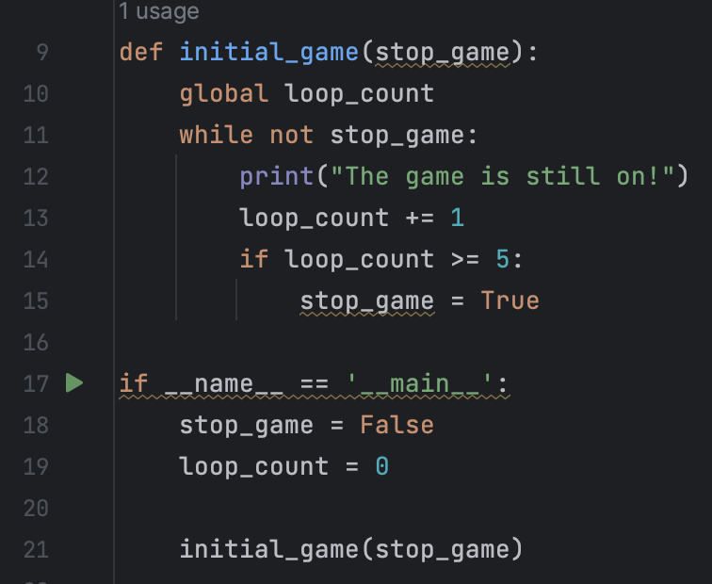
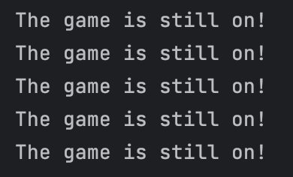
While loop syntax
By using the While keyword we are announcing on a new while loop. Then, we need to provide the stop condition.
The code inside the while loop block will be executed only if the condition is true. Until that condition will be false the code inside the while loop block will be executed forever.
The while loop will stop when the stopGame flag will be true

Slide 13
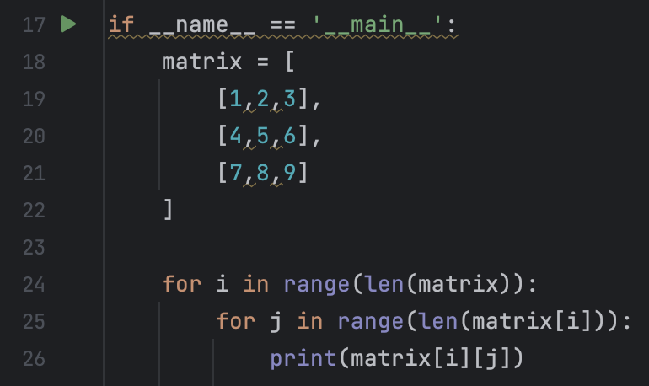

Nested loops
Sometimes we will want to use a loop inside a loop. This condition is called nested loops.
The most common use case for nested loops is when we want to iterate through a matrix. For example: let's say we have a 3X3 matrix and we want to print every element inside of it. Let’s see how we can iterate through this matrix by using 2 nested for loops:
Creating a new 3X3 matrix
First for loop running on the rows of the matrix
Second for loop running on the columns of each row in the matrix

Slide 14
Python loops Summary
Loops in Python and in any other programming language are very powerful tool
By using loops we can easily execute the same code over and over again
Loops also provides us an easy way to iterate through data structures that has more then 1 element inside of them (like array, dictionary, matrix, etc… )
Before using loops we should understand what is the use case we want to achieve and based on that use case decide what is the appropriate loop type to use

Slide 15
Class Exercise - Loops

Slide 16

Class Exercise - Loops
Instructions:
Open your Pycharm project and create new Python package called “Python Loops”
Your mission is to implement all the following instructions
Create 3 new variables that each of them holding a 3X3 matrix
Create new dictionary that has 3 properties. each property will contain each matrix you created
Write a function that get the dictionary you created as a parameter and print all the elements inside the matrix that you saved in it’s second property
Bonus: Implement the same instruction but without using for loops

Slide 17
Class Exercise - Loops Solution

Slide 18
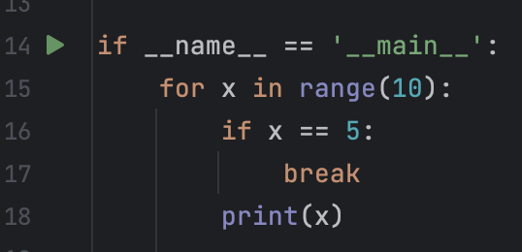

Python Break Keyword
The Python break keyword allow us to “break” or “escape” from a specific block code. Using the break keyword can be useful in order to break from loops and finish the loop iteration immediately. For example: we can use it to “escape” from for loops or while loops:
Because we are using the “break” keyword our for loop has finished its execution after only 4 iterations

Slide 19
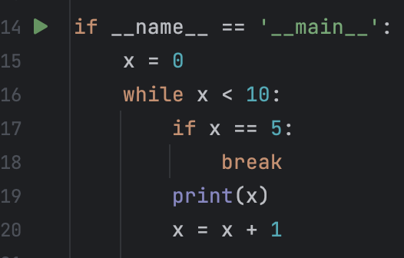
Python Break Keyword
We can also use the break keyword to “jump” from while loops:
Because we are using the “break” keyword our while loop has finished its execution after only 4 iterations

Slide 20

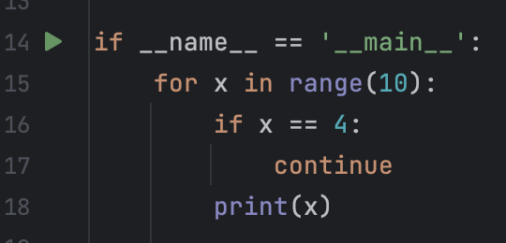
Python Continue Keyword
The Python continue keyword allow us to “breaks” one iteration (in the loop), if a specified condition occurs, and continues with the next iteration in the loop. With the continue keyword we can skip on loop iteration that we don’t want them to execute our loop code.
For example: we can use it to skip an iteration inside a for loops
Because we are using the “continue” keyword our for loop has skip the 4th execution

Slide 21
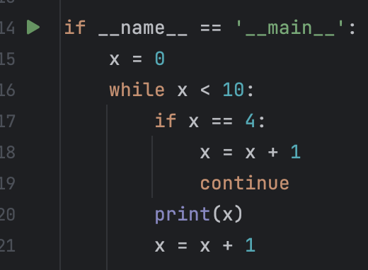
Python Continue Keyword
We can use the continue keyword to skip an iteration inside a while loops
Because we are using the “continue” keyword our for loop has skip the 4th execution

Slide 22
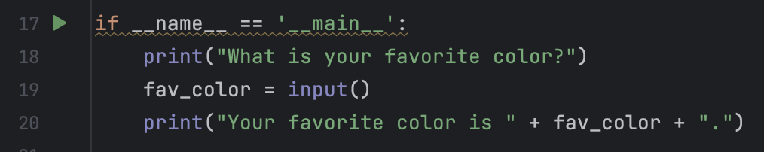
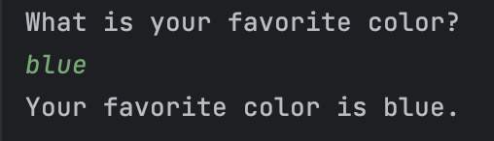
Python Input() function
Python input() function is used to read data that is entered by a user from input devices like keyboard. When used, this function pauses program execution and waits for the user to enter data. Once the user presses enter key, the input() function converts the user entered data into a string and returns it. For example:
We will wait until the user will provide an answer to the question and press on ENTER Than we will store this answer in the fav_color variable
Once we store the answer inside a variable we can use it anywhere we want inside our program

Slide 23
Class Exercise - Input
Instructions:
Open your Pycharm project and create new Python package called “Python Input”
Your mission is to implement all the following instructions:
Implement a program that using the input() function to create some kind of a game menu
The game menu should first ask the user which game he want to play from 3 different options: Blackjack, Memory game, Roulette
Once the user select the game he wants, your program should ask for the user full name

Slide 24
Class Exercise - Input
Instructions:
After providing the name your program should print “Welcome to the game {chosen game} {user full name}”
Once the game started the user will be able to end the game (and the program) by pressing ‘0’
The user will have the ability to exit the game and go back to the main menu and restart his chooses by pressing ‘-1’ from anywhere in the program
Your program should also notify the user about those options as well

Slide 25
Class Exercise - Input Solution

